Slide 1
WELCOME
TO THE NU COMPUTING SOCIETY

Slide 2
About Us
Aiden – President
Callum – Vice-president
Daniel – Treasurer

Slide 3


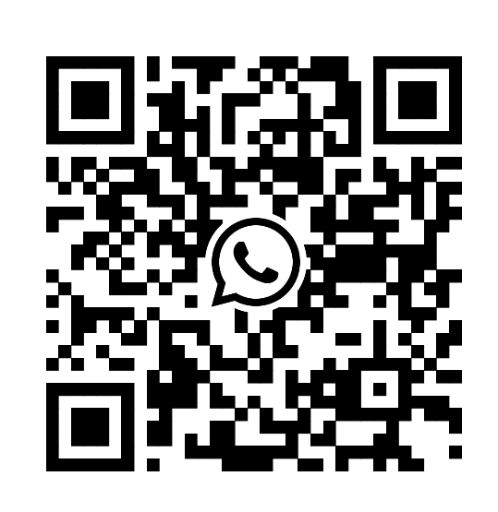
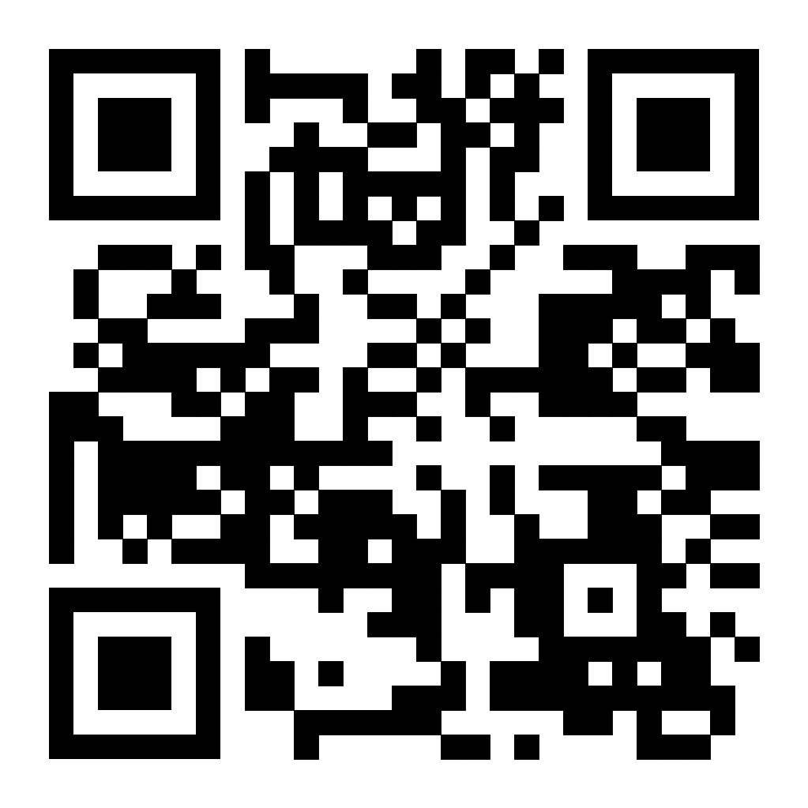
Discord + Whatsapp Groups

Slide 4
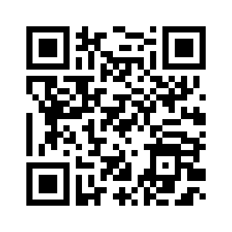
Getting a Discord Role (+Secret Access)
If you are a member of the society and would like to get access to the Discord channels + get a role in the Discord please use the form below.
QR CODE FOR DISCORD ROLE
Form for Discord Role - https://forms.gle/14e112yWPvCX9HNS9

Slide 5
Dreamcode Hackathon
Occurring 7th - 9th in CIS building
Food and drinks included
Check discord for more details and application
Good way to meet people!
Guest speakers and prizes to be won!
Sponsors
Bentley
Buildingsmart international
Bim4water

Slide 6
The plan
Week 1 – Introduction Session
Week 2 – CV workshop / Github Introduction
Week 3 – Itch.io Introduction + Game Jam announced
Week 4 –
Week 5 -
Week 6 - Goodbye

Slide 7
Our goals
Our rules
Get people to make a CV, linkedin, engage with the community and the industry. Job and work training / workshops. Engage with the student union more.
Don’t be weird
Don’t be cringe

Slide 8
Icebreaker
Favourite game
Movie? Book? Tv show?
News?
Pizza and drinks

Slide 9
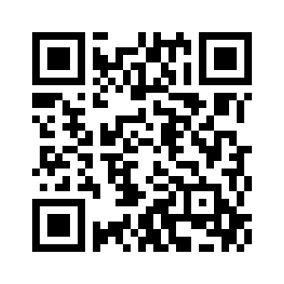

Minecraft Server
We have a minecraft server!
Java 1.21.1
Vanilla
Land claiming
Backpacks
Plugins + More!
Whitelist Link - https://forms.gle/D72579Zgia3QDGWH8
*link will also be put into the discord and whatsapp
QR CODE FOR WHITELIST

Slide 10
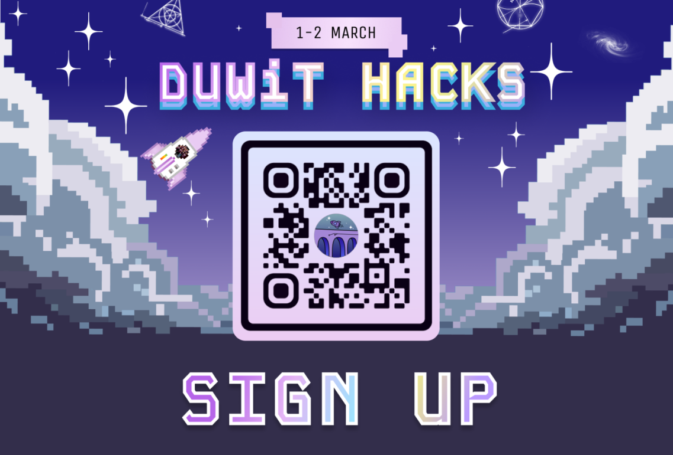
Durham Women In Tech Hackathon (DurWIT Hack)
Durham University's Women in Tech society is excited to invite you too their first ever diversity hackathon, coming to Durham’s Maths and Computer Science building for 24 hrs this weekend! Join us for a dynamic weekend of collaboration and tech project building - we'll have lots of workshops and incredibly wholesome mini events. We welcome everyone from underrepresented genders in tech to sign up!
Meet some sponsors
Learn skills for your CV
Pick up some free food & exclusive stash

Slide 11
Help us!
We are looking for volunteers to help us make new lesson plans / generally help out.
If you would like to help us out let us know!

Slide 12
Next Week
Next week we will focus on CV Building and also an introduction to Github!
Key Points:
Making a CV
Github Profile Creation
Making your first repository
Making your first commit

Slide 13
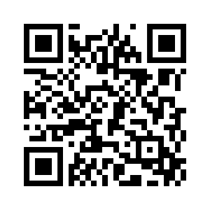
Feedback
Please send us some feedback using this form as it will help these sessions improve!

